Slide 1
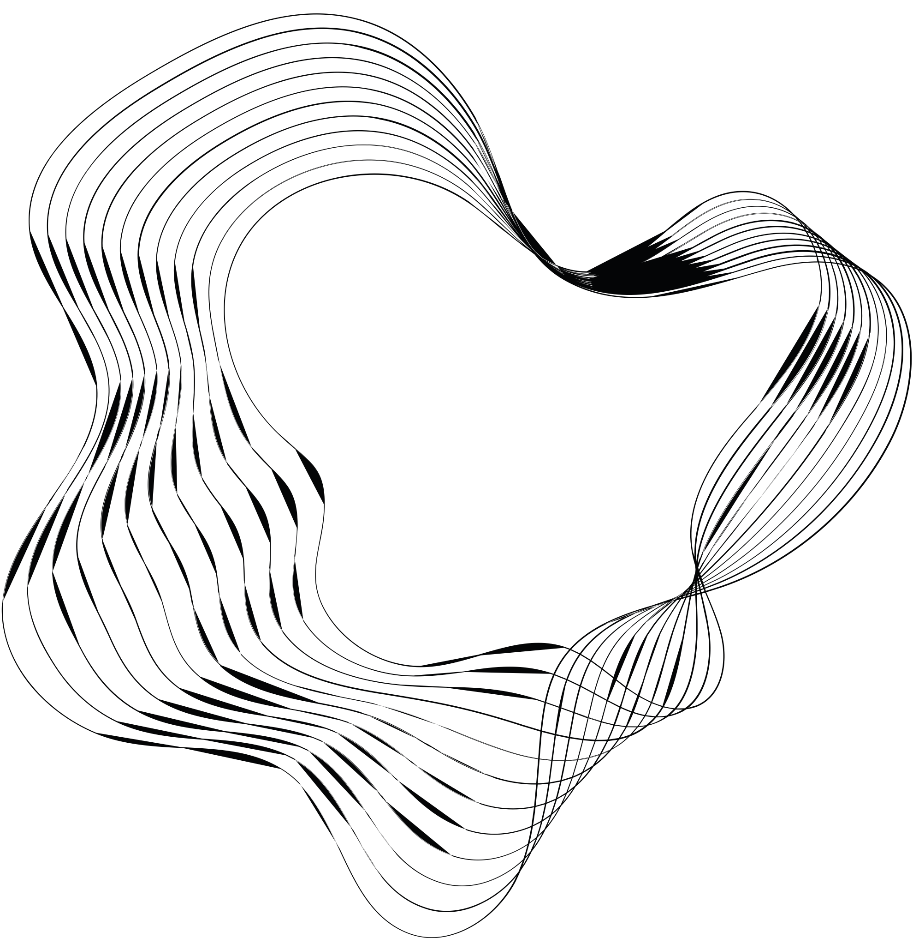

TECHNICAL TASK
STAGE 2
LEYLA NADIRLI

Slide 2

CONTENT
01
Section 1
02
Section 2
03
Section 3

Slide 3
Section 1
Questions
How many unique restaurants could be found in this data set? (Hint: Use the [Business_ID] column for this evaluation.)
Which restaurant received the highest number of reviews? What about percentage-wise?
Which cities have got at least one 5-star review in Nevada (NV) state?
Which city has the highest number of reviews in the Business Category of “Hotels & Travel”? What about percentage-wise?
At what day of the week people are more likely to post their reviews?
Showcase if there are any trends regarding restaurant performance as time goes by.
Based on analyzed data showcase if there are any steps that the restaurant can take to improve their public appeal.
Bonus Question – Based on this data set which user had the highest cumulative travel distance? What distance has been covered by him/her?
Solutions
.nunique() function
.groupby() based on Business Name and Review_text counts, then sorting. After finding highest one, with simple math we can find percentage of this restaurant.
.query() function for filtering data, then selecting Cities with .unique()
Simple filter, then .groupby(), .count() and sorting. After sorting simple math to find percentage.
Change to date format, creating new column based on .dt.day_name(), then groupby with this column and Review_text.
Groupby with Review_date.dt.year() function and Review_text. Then show with sns.lineplot(). In addition, same function, however with Avg_Business_Star_Rating. Lastly, with groupby, states who gives highest rates were determined and I find business categories with a lot of reviews and highest rating.
There are several steps can be applied to improve public appeal .
Firstly, search about what is cumulative travel distance in this dataset. Then using geodesic library, I wrote function to find distance between coordinates of reviews’ places. Then with groupby of USERID and this new metrics, I find maximum distance and it’s owner.

Slide 4
Findings
30276 restaurants could be found in this dataset.
Hash House A Go Go received the highest number of reviews with 962 texts and 0.42270849811055455%.
['Las Vegas' 'Henderson' 'Boulder City' 'Nellis'] have got at least one 5-star review in NV.
Las Vegas has the highest review in Hotel and Travel Business Category with 10245 reviews and 77.64304660856385%.
Most of people choose to give review on Monday.
Until 2013, the number of reviews are increasing, in the 2013 people tend to make more reviews (a). People tend to give more than 3.5 star and tend to increase rating over the period (b). MN and NY are the most rating states. However NTH has least rating states (c). We can see that food sector has both high ratings and a lot of reviews (d, e).
Given that MN and NY are already exhibiting robust performance, restaurants in these states ought to leverage this by putting a lot of emphasis on good reviews on their websites and social media, encouraging even more good comments by rewarding customers who post evaluations with loyalty programs or discounts, partnering with regional food bloggers or influencers in these states with good ratings to help advance their reputation. In states with lower ratings, like North Dakota (NTH), eateries ought to get detailed consumer comments to find out why the ratings are so low, comment cards and surveys have their uses and based on the input received, enhance the eating experience, menu options, and customer service. Encourage more online reviews by providing incentives for customers to submit feedback, as we have noticed a significant volume of reviews in the food industry. Marketing campaigns like "Write a review and receive a free dessert" can improve visibility and customer happiness.
The user with the highest travel distance is User ID AtEYAeRoJ_6YKMMour2wVw, with a total distance of 8083.112806808389 km.

Slide 5
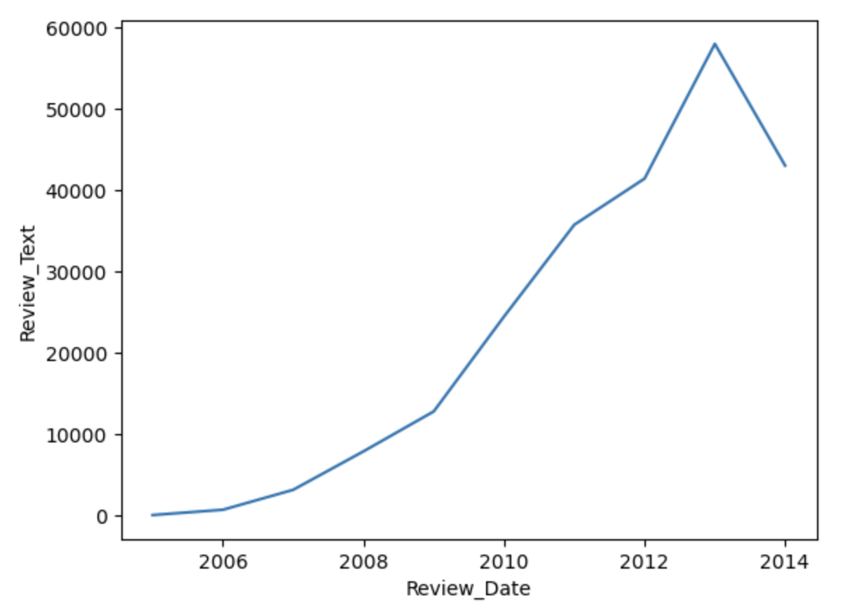
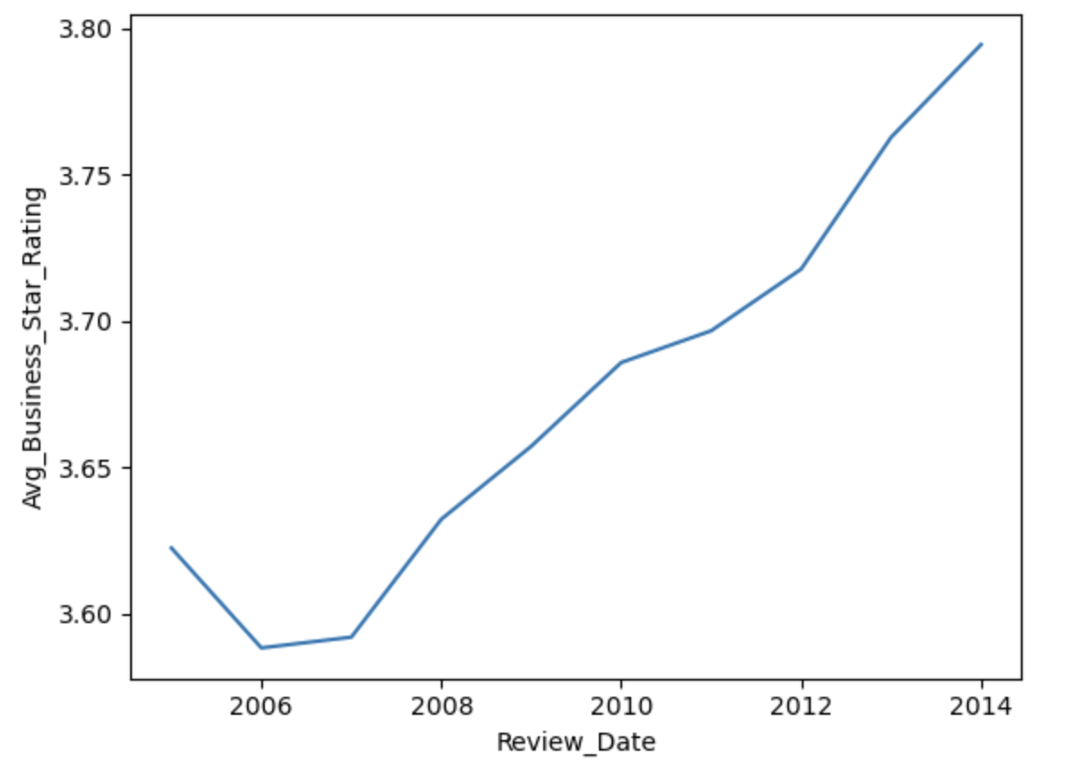
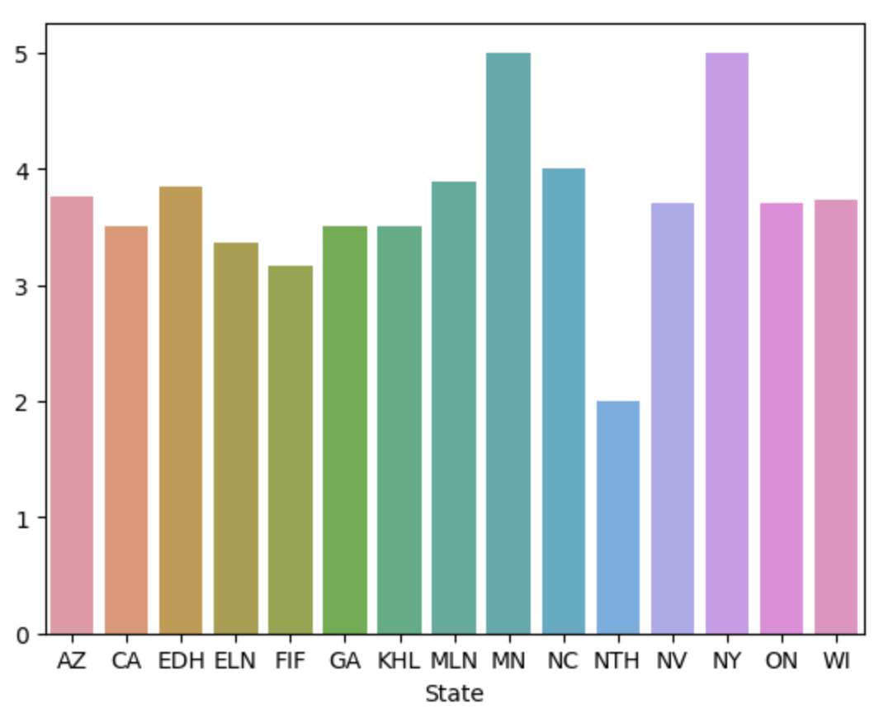
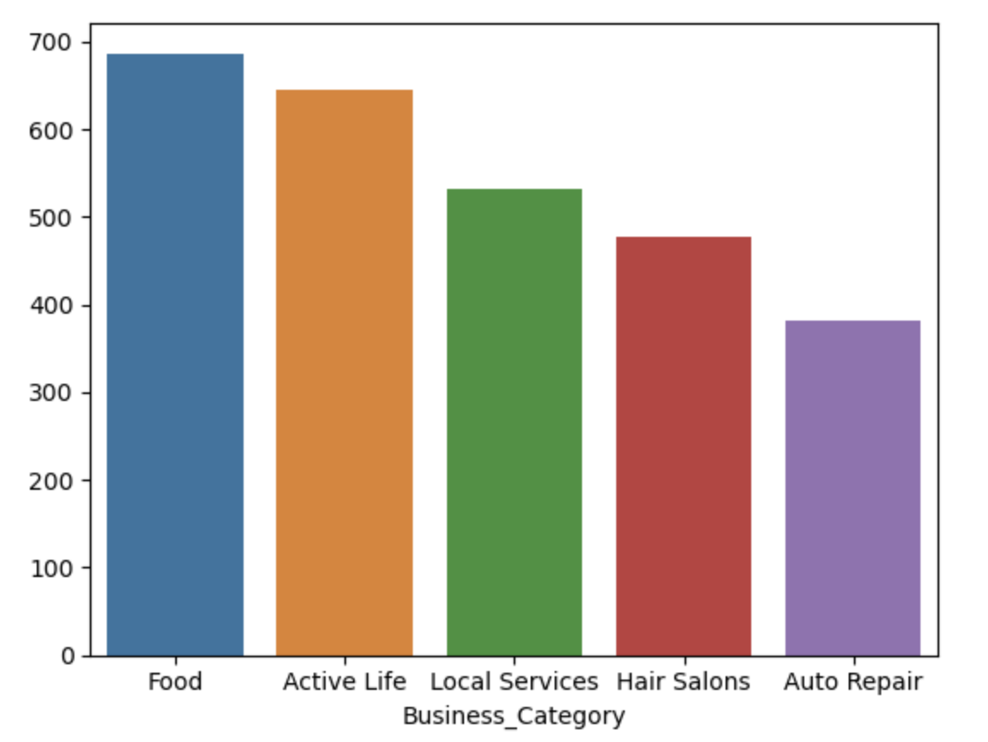
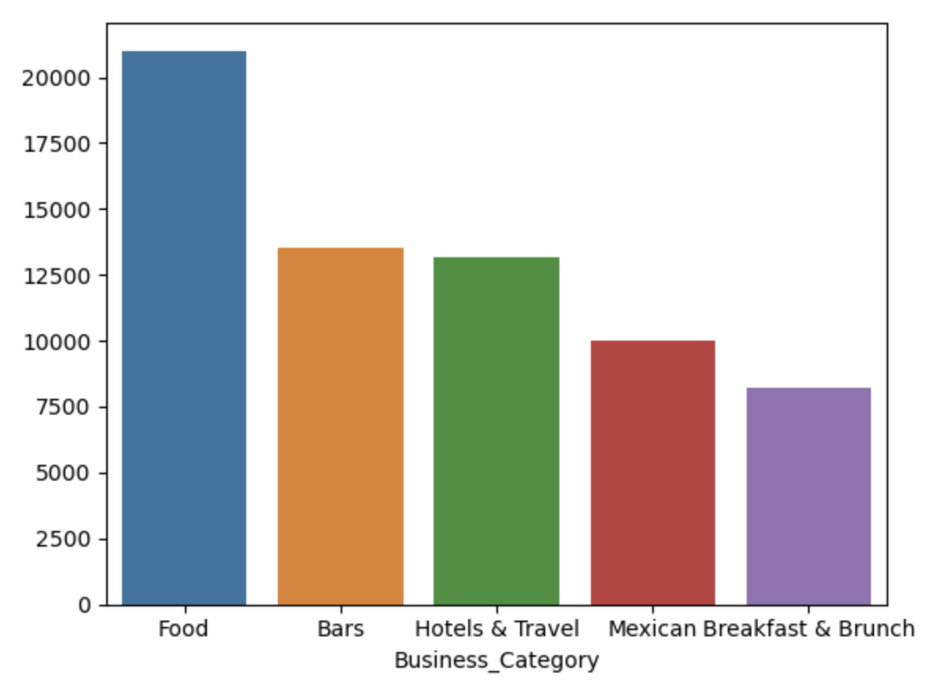
a) Number of reviews based on year
b) Average Business Rate based on Year
c) Average Business Ratings based on States
d) Highest rank and reviews business categories
e) Top 5 business categories based on number of reviews

Slide 6
Section 3
Questions
Part 1. Create an algorithm that generates an NxN matrix filled with the numbers in a specific pattern starting from the center. This matrix should follow the pattern illustrated in the attached image.
Input: An integer N representing the size of the square matrix (NxN).
Output: A NxN matrix filled with numbers starting from 1 at the center and moving outward in a clockwise manner increasing sequentially, filling the matrix completely.
Part 2. Calculate and print the sum of the numbers along both diagonals of the result matrix (primary and secondary).
Input: Result matrix from the first part.
Output: Sums of the diagonals separately.
Solutions
Part 1. In this code, I implemented a function called clock_matrix(N) that creates an NxN matrix filled with numbers in a clockwise spiral pattern starting from the center. The matrix is initialized with zeros, and the center is determined based on the size N. Starting from the center position, the function uses directional vectors to move right, down, left, and up, filling the matrix with sequential numbers. The algorithm employs a loop that adjusts the number of steps taken in each direction, increasing the step count after completing a full cycle of two directional moves. This process continues until the entire matrix is filled with numbers from 1 to N², resulting in a visually appealing spiral layout. The final spiral matrix is printed to verify the output.
Part 2. In this code, I created a function called sum_diagonals(matrix) that calculates the sums of both the primary and secondary diagonals of a given square matrix. The function first determines the size of the matrix (assuming it's NxN) and initializes two variables to hold the sums of the diagonals. It then iterates through each row of the matrix, updating the primary diagonal sum by adding elements where the row index equals the column index, and updating the secondary diagonal sum by adding elements where the row index plus the column index equals N - 1. After defining this function, I tested it using a previously generated spiral matrix of size N = 5, and printed the resulting sums of both diagonals, effectively demonstrating the functionality of the implemented method.

Slide 7
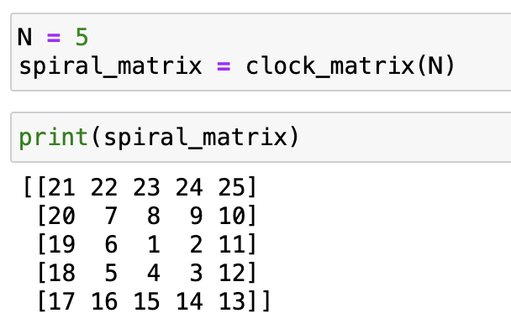
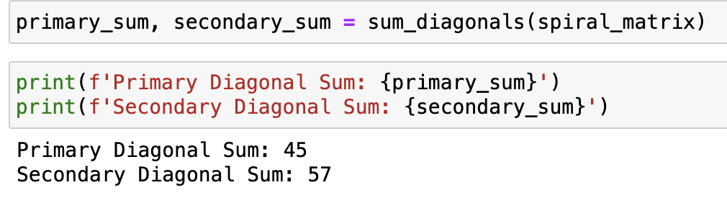
Findings
Part 1 result
Part 2 result

Slide 8
Section 2
Questions
You are provided with Distributed Acoustic Sensing data (Distributed acoustic sensing - Wikipedia). The fiber cable is sticked to the outside of pipe which goes down to the earth for couple of kilometers. Inside of the pipe is liquid flow. Spatial discretization is 1m (each row in the dataset corresponds for specific depth) and temporal resolution is 1 minute (each column in the well corresponds to a minute).
Your task is to implement some coding with further interpretations/observations of results:
• Brief description of Distributed Acoustic Sensing (DAS) working principle and cases of its applications
• Do data observations: some statistical analysis to get to know your data as well as various types of visualizations and insights from them
• Implement at least one algorithm (coding in Python, MATLAB, etc.) for line detection in the given signal using spatiotemporal data. Implementation of additional algorithm and its comparison with the first one is highly welcomed
• Describe properties of the lines in case they are detected (algorithmically)
Solutions
After gaining deep understanding how DAS is working and what is its’ principles, I used descriptive statistics to observe dataset. For line detection in this algorithm, Haugh Transform and Gradient-Based method were applied. Using a voting process in parameter space, the Hough Transform is a feature extraction method that may identify objects with imperfections. When applied to lines, it reduces a challenging global detection problem in image space to a local peak detection problem in parameter space that is simpler to solve. The gradient method detects the edges by looking for the maximum.

Slide 9

Findings
A measurement method called Distributed Acoustic Sensing (DAS) uses fiber-optic cables as a strain or strain-rate sensor along the cable. The ETH Zürich recently began tracking the seismic sequence and possible eruption at Grindavik, Iceland, in cooperation with the Icelandic Met office IMO and HS Orca. Glacier seismology is another excellent application for fiber-optic cables. The use of subsea cables to follow and locate various whales based on their songs collected with DAS is another fascinating application.
The columns' average values are about 4-5, indicating that most observations fall within this range on average. With some columns showing a standard deviation as high as 7.15 (indicating a broad variety of values), the values vary greatly. This implies that some columns are highly variable, most likely pointing to outliers or wider ranges at particular depths or time intervals.

Slide 10
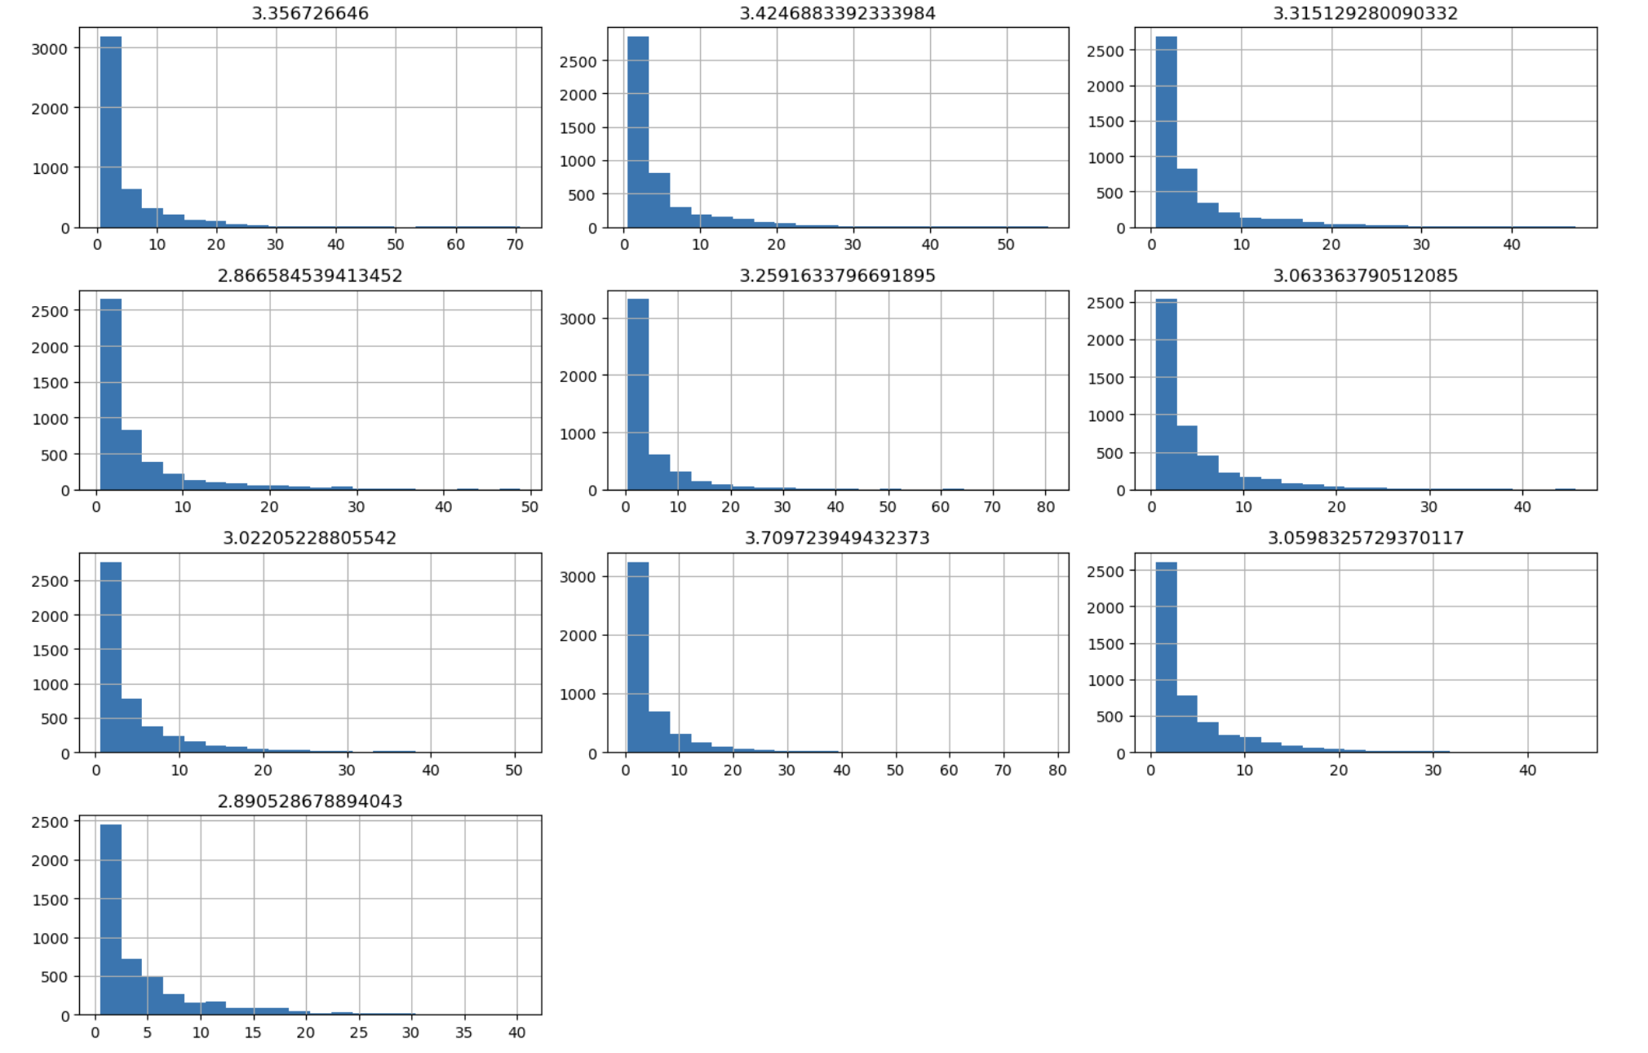
Every histogram shows a distribution that is heavily skewed to the right, with a long tail that extends to higher values and the majority of values clustered close to zero. Each plot's peak frequency usually falls between 2500 and 3000 counts in the lowest bin, indicating that the majority of samples show comparatively little acoustic activity or signal strength.
Instead of being a random variation, the shape consistency across all histograms suggests that this is a distinctive pattern of the sensing device or the thing being seen. This kind of distribution is common in acoustic sensing applications, where a large number of low-magnitude readings are produced by background noise or normal conditions, while greater magnitude values are produced by less frequent occurrences or signals of interest.

Slide 11
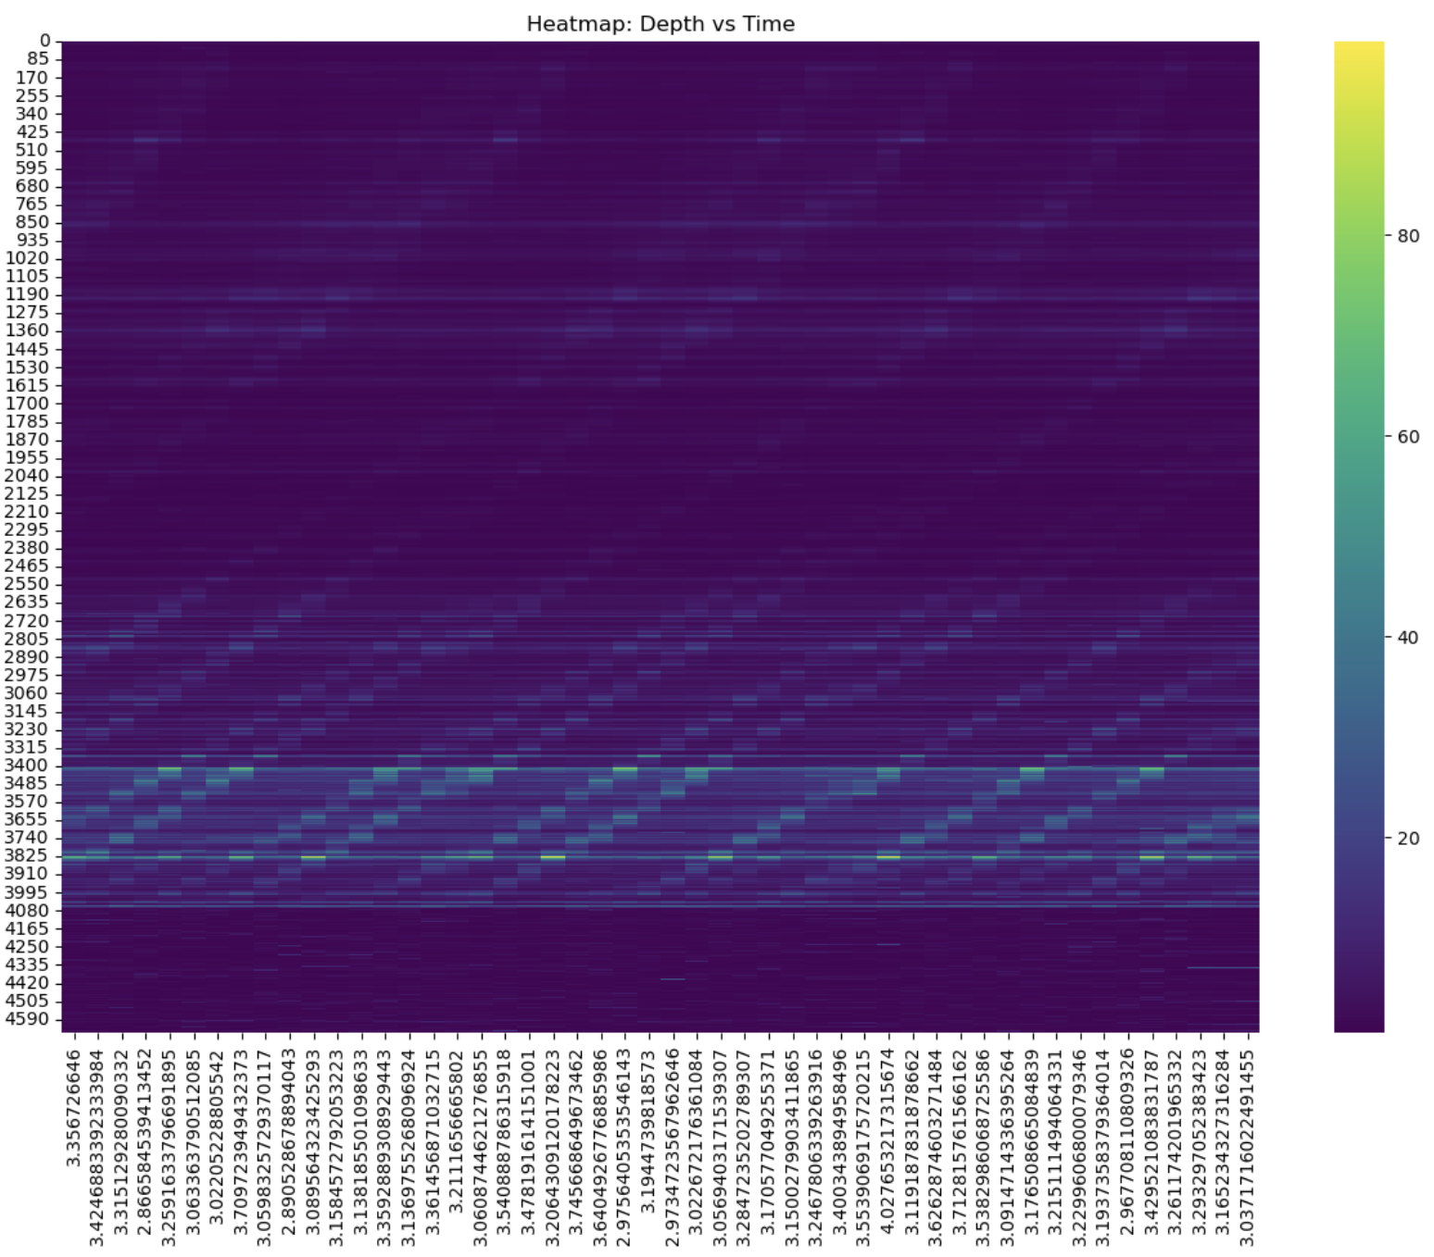
Significant activity is observed at depths of 3400–4000 meters, with a distinct banding pattern that displays recurring rises in values. Conversely, there is minimal fluctuation and persistently low levels at the higher depths (0–2500 meters). Particularly in the 3400–4000 metre range, the x-axis progression shows a cyclical pattern in the active regions, indicating frequent fluctuations in the observations or recurrent events.The majority of high-intensity regions only extend into the blue-green range (about 40–60), with peak intensities being comparatively uncommon and localised, according to the colour scale, which goes from 0 (purple) to about 80–100 (yellow).

Slide 12
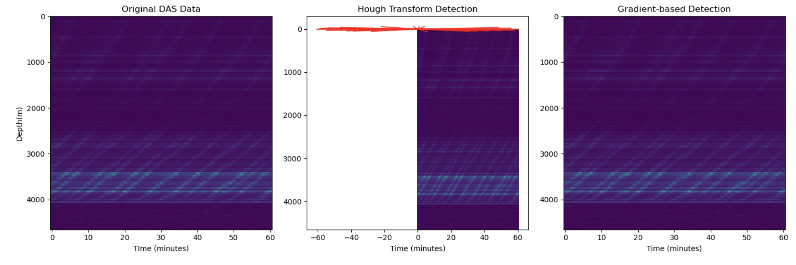
I aimed to create a robust framework for detecting lines in Distributed Acoustic Sensing (DAS) data through two primary methods: Hough Transform detection and gradient-based detection. The goal was to preprocess the data by standardizing it and applying a median filter to reduce noise, thus enhancing the clarity of the detected features. While the initial results showed some promise, the line detection was not as effective as anticipated.
For instance, the Hough Transform struggled to accurately identify distinct lines due to the presence of noise and variations in the data, leading to many false positives or undetected lines. Similarly, the gradient-based method failed to capture the subtle features in the dataset, resulting in incomplete or fragmented line segments. Despite these challenges, the exploration of different techniques highlighted areas for improvement, such as optimizing the parameters for edge detection and refining the algorithm for better noise reduction, ultimately guiding the next steps in enhancing the line detection process.

Slide 13




When lines are detected using the Hough Transform, several key properties are revealed. The angle of the line indicates its orientation, whether it is more vertical, horizontal, or diagonal, measured in radians relative to the horizontal axis. The distance represents the shortest path from the origin (usually the top-left corner of the data matrix) to the line, giving a clear indication of where the line is positioned. The strength reflects how prominent the line is in the Hough space, indicating how well-defined and distinct the line is compared to others. Stronger lines signify more pronounced linear structures in the data.
In contrast, the gradient-based method detects line segments using localized changes in the data's gradients. Here, the start point and end point define the spatial extent of the detected line, outlining the specific area where changes occur. The strength of a line in this context is based on the gradient magnitude, with larger values corresponding to more significant variations in the data. Additionally, the direction of the line provides insight into the average orientation of the detected changes, showing the direction of the most significant variations. This method is particularly sensitive to localized variations and can capture fine-scale structures.

Slide 14

Thank you!

